Slide 1
JavaScript Part 3

Slide 2

Hello world!
I AM ALMARIE SAAYMAN
You can message me directly on the meetup group.

Slide 3
1
RECAP – JavaScript Part 2

Slide 4
Recap – Data Types
Data Type | Example
String | let name = "Jane";
Number | let age = 23;
Boolean can be either true or false | let isEmployed = true;
When a variable is declared, but not assigned a value it is Undefined | let a; alert(a); // Output: undefined

Slide 5
Recap – Data Types Continued
Data Type | Example
An Array can hold multiple values in a single variable | let cities = ["Johannesburg", Pretoria", "Cape Town"];
An Object is a collection of data, usually defined as key-value pairs | let person = { name : "Jane", surname: "Doe" age : 23, isEmployed : true };

Slide 6
Recap – Data Type Conversion
let a = "16";
let b = 4;
let result = a + b; // Output: 164
Any value added to a variable that contains a String will automatically be converted into a String.

Slide 7
Recap – Data Type Conversion Continued
If you want the result to be the addition of the Number 16 and the Number 4, then you can convert the String to a Number like this:
let a = "16";
let b = 4;
let result = Number(a) + b; // Output: 20

Slide 8
Recap – Comparison Operators
Comparison Operator | Example | Boolean Result
 | let a = 2; let b = 5; let c = 5;
Greater than | alert(a > b); | false
Less than | alert(a < b); | true
Equal to | alert(a == b); | false
 | alert(c == b); | true
Not equal to | alert(a != b); | true

Slide 9
Recap – Arrays
Each value in an Array is called an element and has an index. Indexes start at 0 not at 1.
let cities = ["Johannesburg", "Pretoria", "Cape Town"];
You can retrieve an element in the Array by index:
let firstCity = cities[0]; // firstCity = "Johannesburg"
0
1
2

Slide 10
Recap – Arrays Continued
let cities = ["Johannesburg", "Pretoria", "Cape Town"];
Helper Methods | Description
cities.length | Returns the number of elements in the array
cities.pop() | Removes the last element in the array
cities.push("Durban") | Adds a new element to the end of the array
cities.concat(moreCities) | Merges the moreCities array into the cities array
cities.sort() | Sorts an array alphabetically
cities.reverse() | Reverses the elements in the array
cities.forEach() | Iterates through each element in the array

Slide 11
Recap – Objects
Collection of data.
let person = {
name: "Jane",
surname: "Doe“,
age: 23,
isEmployed: true
};
Object

Slide 12
Recap – Objects
Collection of data.
let person = {
name: "Jane",
surname: "Doe“,
age:: 23,
isEmployed: true
};
Properties / Keys

Slide 13
Recap – Objects
Collection of data.
let person = {
name: "Jane",
surname: "Doe“,
age: 23,
isEmployed: true
};
Values

Slide 14
TODAY: JavaScript Part 3
Functions
Events
Logical operators
Conditional statements
Loops

Slide 15
Functions
A block of code designed to perform a particular task
Notes:
Functions are often also referred to as ‘Methods’.

Slide 16
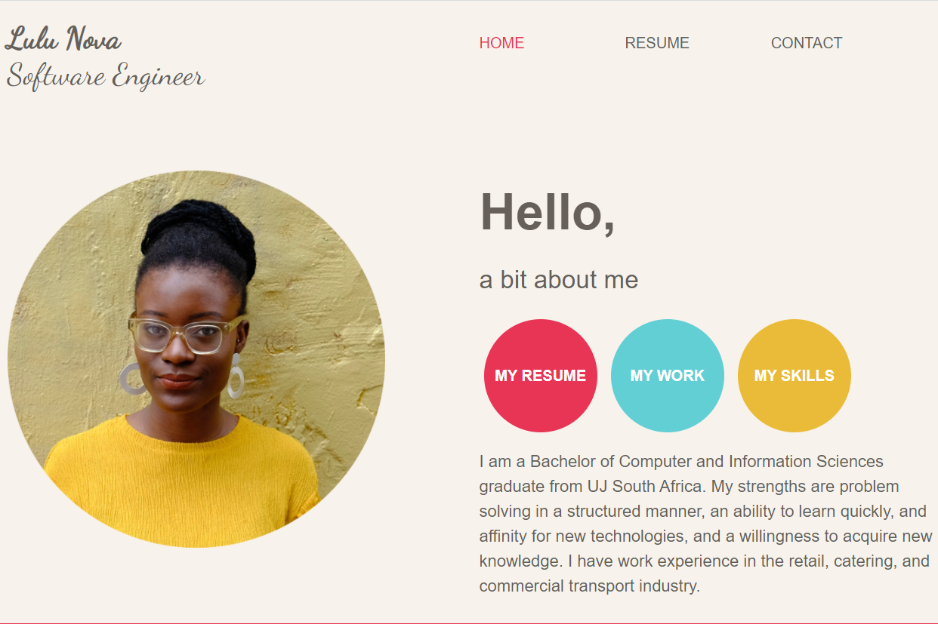
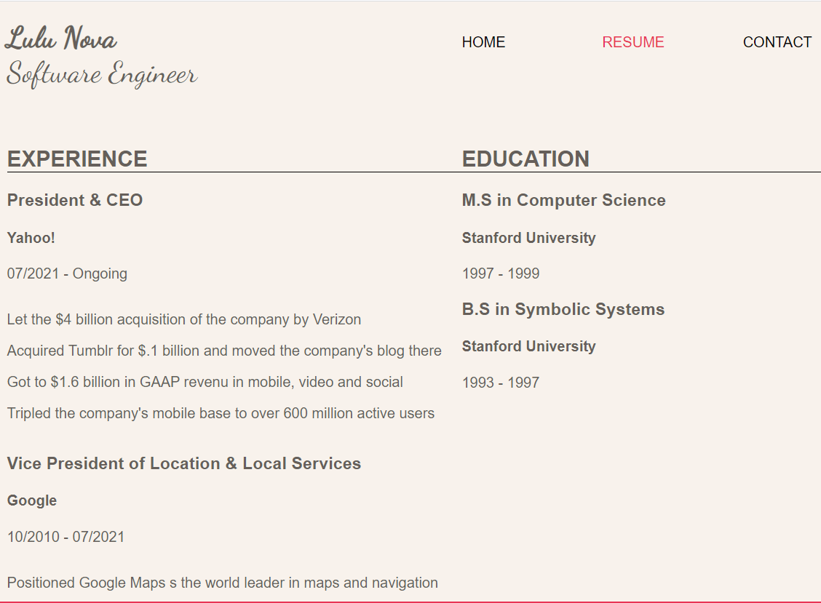
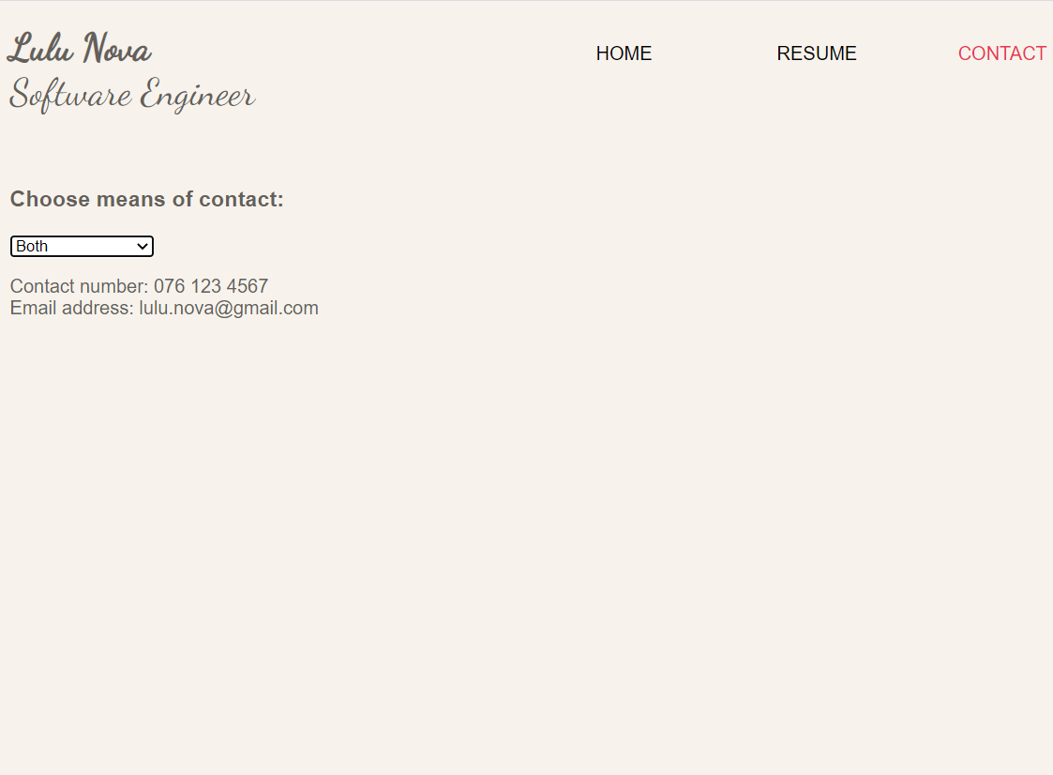
The concept of a function
Sometimes when we code, patterns emerge. For example, every time we click on a navigation button, we want to see the page content related to that navigation button.
Notes:
Because of this pattern, we can use a function to write the base code required to make the navigation functional. This base navigation code becomes re-usable the moment you add the base code into a function.

Slide 17
The structure of a function
function functionName(parameter1, parameter2, parameter3) {
// first line of code to execute
// second line of code to execute
// third line of code to execute
}
Keyword – This MUST be here
Notes:
Every single time you want to define a function you have to start with the keyword ‘function’.
Going forward when you see yellow it means that forms part of the structure of the concept being explained.

Slide 18
The structure of a function
function functionName(parameter1, parameter2, parameter3) {
// first line of code to execute
// second line of code to execute
// third line of code to execute
}
The name of the function – You must decide what to call the function
Notes:
When you see blue it means that that is information that you are in control of.
Always give your function a name that makes sense for the code that is executed within the function. For example, if you have a function that adds 2 numbers together it makes sense to name the function something like ‘add()’.
Function names can contain letters, digits, underscores, and dollar signs.

Slide 19
The structure of a function
function functionName(parameter1, parameter2, parameter3) {
// first line of code to execute
// second line of code to execute
// third line of code to execute
}
Parentheses – Opening and closing parentheses MUST be directly after the function name

Slide 20
The structure of a function
function functionName(parameter1, parameter2, parameter3) {
// first line of code to execute
// second line of code to execute
// third line of code to execute
}
Parameters – There CAN be a comma separated list of parameters, but it is not a must.
Notes:
These parameters are essentially variables that you want to use within your function to complete some task.

Slide 21
The structure of a function
function functionName(parameter1, parameter2, parameter3) {
// first line of code to execute
// second line of code to execute
// third line of code to execute
}
Curly brackets – These MUST be here, they define the scope of the function
Notes:
When I say they define the scope of the function I mean they define what code must be executed as part of this function. Any code that is outside of these curly brackets will not execute when the function is called/invoked.
It is also important to know that you can only use the parameters passed to the method between the curly brackets, if you attempt to use one of these parameters outside of the function that value will be undefined.

Slide 22
The structure of a function
function functionName(parameter1, parameter2, parameter3) {
// first line of code to execute
// second line of code to execute
// third line of code to execute
}
Code – These lines of code will execute in a sequential order
Notes:
This will be your re-usable code.

Slide 23
How to execute the function
Usually referred to as ‘invoking’ or ‘calling’ the function.
functionName(argument1, argument2, argument3);
Use the name you gave your function

Slide 24
How to execute the function
Usually referred to as ‘invoking’ or ‘calling’ the function.
functionName(argument1, argument2, argument3);
The name of the function must be followed by parentheses and then a semi-colon

Slide 25
How to execute the function
Usually referred to as ‘invoking’ or ‘calling’ the function.
functionName(argument1, argument2, argument3);
Arguments, the values to be used in your function
Notes:
It’s important to know, when defining a function, the variables between the parentheses are referred to as parameters, however when invoking/calling a function the variables between the parentheses are referred to as arguments.
The argument count should match up with the parameter count on the function.

Slide 26
Functions can return values
function functionName(parameter1, parameter2, parameter3) {
// first line of code to execute
// second line of code to execute
// third line of code to execute
return value;
}
Keyword – You MUST use this keyword IF you want to return a value

Slide 27
Functions can return values
function functionName(parameter1, parameter2, parameter3) {
// first line of code to execute
// second line of code to execute
// third line of code to execute
return value;
// This line of code will NOT execute
}
Notes:
The moment the ‘return’ keyword is encountered the function will return the value immediately, meaning any code you wrote after that return keyword will not execute.

Slide 28
Let’s look at a better example
1. let quotient = divide(10, 2);
2.
3. function divide(dividend, divisor) {
4. let result = dividend / divisor;
5. return result;
6. }
Notes:
On line 1, we invoke/call the divide function and the arguments passed to the function is 10 and 2
On line 3, we define the function with name ‘divide’ and it takes in 2 parameters
On line 4, we use the parameters to do the division and assign the result of the equation to the ‘result’ variable
On line 5, we return the result of the division to line 1, where 5 would be assigned to the variable ‘quotient’

Slide 29
Events
Something the browser or user does

Slide 30
What are events?
Events is something the browser or user does. For example:
The user clicked on a button (User event)
The user updated an input field (User event)
The web page has finished loading (Browser event)

Slide 31
How do we execute code when these events happen?
Simply define onclick event on the html element. When the user clicks on the HOME button the onclick event will trigger and the navigateTo() function will be invoked with the ‘home’ argument.
<button onclick="navigateTo('home')">HOME</button>
Notes:
You can also use this onclick event on other html elements, it doesn’t have to be a button.

Slide 32
Here are some other types of events
Event | Description
onchange | Triggers when an html element changed
onmouseover | Triggers when the user moves their mouse over the html element
onmouseout | Triggers when the user moves their mouse away from the html element
onkeydown | Triggers when the user pushes a keyboard key
onload | Triggers when the browser has finished loading the web page
Notes:
You can use these events just like how you would use the onclick event.

Slide 33
Events Demo

Slide 34
Logical Operators
Determines the logic between variables and values

Slide 35
Types of logical operators
Operator | Description | Example | Outcome
&& | and | (5 > 2) && (2 < 5) | true
 |  | (5 > 2) && (2 > 5) | false
|| | or | (5 > 2) || (2 < 5) | true
 |  | (5 > 2) || (2 > 5) | true
 |  | (5 < 2) || (2 > 5) | false
! | not | !(5 == 2) | true
 |  | !(5 == 5) | false
Notes:
The code gets analysed from left to right.
So, if the operator is && it will ALWAYS evaluate the expression before AND after the operator and only if both evaluates to true will the outcome be true.
If the operator is || it will evaluate the expression before the operator first, if it is true, it doesn’t bother evaluating the expression after the operator. But if the expression before the operator evaluates to false it will also evaluate the expression after the operator.
The not operator just flips the bit. So, if the expression evaluated to true the outcome will be false, and if the expression evaluated to false the outcome will be true.

Slide 36
When would you need to use these logical operators?
You typically use these logical operators when doing comparisons. For example, based on some condition you want to execute some code.
if(isEmployed && isUnderSixtyFive) {
// Code to execute
}
Notes:
Don’t worry to much about the ‘if’ being used here, we’ll dive deeper into that next.
Above the code between the curly brackets will only execute if isEmployed and isUnderSixtyFive is true.
Comparisons are a big concept when it comes to any development language since that is how we control the flow of our code.

Slide 37
Conditional statements
Performs an action based on a condition

Slide 38
What are conditional statements?
When coding you want different actions to execute on different conditions. These conditional statements help with that. These conditional statements include:
If
Else
Else if
Switch

Slide 39
Conditional statement - If
You can use if to specify what block of code (code between curly brackets) must be executed if the condition is true.
if(hour < 12) {
alert("Good morning!");
}
Keyword – This MUST be here

Slide 40
Conditional statement - If
You can use if to specify what block of code (code between curly brackets) must be executed if the condition is true.
if(hour < 12) {
alert("Good morning!");
}
Parentheses – Opening and closing parentheses MUST be directly after ‘if’

Slide 41
Conditional statement - If
You can use if to specify what block of code (code between curly brackets) must be executed if the condition is true.
if(hour < 12) {
alert("Good morning!");
}
Condition for executing the code block

Slide 42
Conditional statement - If
You can use if to specify what block of code (code between curly brackets) must be executed if the condition is true.
if(hour < 12) {
alert("Good morning!");
}
Code block that will execute if the condition evaluates to true

Slide 43
Conditional statement - Else
You can use else to specify what block of code (code between curly brackets) must be executed if the condition is false.
if(hour < 12) {
alert("Good morning!");
} else {
alert("Hello!");
}
Keyword – This MUST be here
Notes:
You cannot have an ‘else’ block of code without first defining the ‘if’ block of code.
The ‘else’ block is the default code that will get executed if the condition between the ‘if’ parentheses evaluates to false.

Slide 44
Conditional statement - Else
You can use else to specify what block of code (code between curly brackets) must be executed if the condition is false.
if(hour < 12) {
alert("Good morning!");
} else {
alert("Hello!");
}
Code block that will execute if the condition evaluates to false

Slide 45
Conditional statement – Else If
You can use else if to specify a new condition if the first condition is false.
if(hour < 12) {
alert("Good morning!");
} else if(hour > 12 && hour < 18) {
alert("Good afternoon!");
} else {
alert("Hello!");
}
Keyword – This MUST be here

Slide 46
Conditional statement – Else If
You can use else if to specify a new condition if the first condition is false.
if(hour < 12) {
alert("Good morning!");
} else if(hour > 12 && hour < 18) {
alert("Good afternoon!");
} else {
alert("Hello!");
}
Alternate condition if the first condition evaluated to false
Notes:
It’s important to know you can have many of these else if blocks.

Slide 47
Conditional statement – Else If
You can use else if to specify a new condition if the first condition is false.
if(hour < 12) {
alert("Good morning!");
} else if(hour > 12 && hour < 18) {
alert("Good afternoon!");
} else {
alert("Hello!");
}
Code block that will execute if the ‘else if’ condition evaluates to true

Slide 48
Conditional statement – Switch
You can use switch to select one of many code blocks to be executed.
switch(hour) {
case 11:
alert("Good morning!");
break;
case 12:
case 13:
case 14:
case 15:
alert("Good afternoon!");
break;
default:
alert("Hello!");
}
Keywords – These MUST be here
Notes:
break will stop the execution within the switch block.

Slide 49
Conditional statement – Switch
You can use switch to select one of many code blocks to be executed.
switch(hour) {
case 11:
alert("Good morning!");
break;
case 12:
case 13:
case 14:
case 15:
alert("Good afternoon!");
break;
default:
alert("Hello!");
}
If the condition matches any of these case values, the code block defined for that case will execute
Notes:
default specifies the code to run if none of the case values matches the condition.

Slide 50
Conditional Statements Demo
Notes:
Show demo of if statements used on contact page in CV.

Slide 51
Loops
Iteratively executing code

Slide 52
What are loops?
You can use loops to run the same code over and over again, each time with a different value. Here are the different kind of loops:
For
For/In
While
Do/While

Slide 53
Loops - For
This is the structure of a for loop.
for (statement 1; statement 2; statement 3) {
// code block to be executed
}
Keyword – This MUST be here

Slide 54
Loops - For
This is the structure of a for loop.
for (statement 1; statement 2; statement 3) {
// code block to be executed
}
Parentheses – Opening and closing parentheses MUST be directly after the for keyword

Slide 55
Loops - For
This is the structure of a for loop.
for (statement 1; statement 2; statement 3) {
// code block to be executed
}
Typically, there would be exactly 3 statements between the parentheses
Notes:
These statements are how you control the amount of times your for loop executes.

Slide 56
Loops - For
This is the structure of a for loop.
for (statement 1; statement 2; statement 3) {
// code block to be executed
}
Statement 1 is normally used to initialise the variable that gets used to keep track of the number of times the code has executed.
Executes once before the execution of the code block
Notes:
By code block I mean, the code in between the curly brackets/the code we want to execute iteratively.

Slide 57
Loops - For
Let’s set statement 1 to something meaningful.
for (let iteration = 0; statement 2; statement 3) {
// code block to be executed
}
Above we have set the variable iteration to 0 before anything else happens.
Notes:
It’s important to note that typically in many development languages we usually start the index at zero when looping.
The reason for that is that arrays start at index zero.
It makes it easier to use the existing index instead of having to subtract one from the index every time.
However, you can set this index to any number you want depending on where in the array you want to start your iterations.
I’ll do a quick demo of this in a short while.

Slide 58
Loops - For
We can also omit statement 1, but the semi-colon must be there to indicate that statement 2 follows.
for (; statement 2; statement 3) {
// code block to be executed
}
Above we are not making any initialisations before the first iteration of our code block executes.

Slide 59
Loops - For
This is the structure of a for loop.
for (let iteration = 0; statement 2; statement 3) {
// code block to be executed
}
If the condition evaluates to true, the code block will execute.
If the condition evaluates to false the loop would end.
Condition for executing the code block

Slide 60
Loops - For
Let’s set statement 2 to something meaningful.
for (let iteration = 0; iteration < 5; statement 3) {
// code block to be executed
}
Above we are saying that we should end the loop if iteration is less than 5.
At the start of this loop iteration would be 0, next the condition gets evaluated, and since 0 is less that 5 the code block will execute.

Slide 61
Loops - For
We can also omit statement 2, but the semi-colon must be there to indicate that statement 3 follows.
for (;; statement 3) {
// code block to be executed
}
Above we are not indicating on what condition the loop should end. The loop will keep on executing until we force it to end with the break keyword.
Notes:
I’ll talk a little more about break later on.

Slide 62
Loops - For
This is the structure of a for loop.
for (let iteration = 0; iteration < 5; statement 3) {
// code block to be executed
}
Statement 3 is normally used to increment/decrement the initialised variable that gets used to keep track of the number of times the code has executed. That way your loop will eventually end.
Executes every time after the code block has been executed
Notes:
By increment I mean increase the value and decrement I mean to reduce the value.

Slide 63
Loops - For
Let’s set statement 3 to something meaningful.
for (let iteration = 0; iteration < 5; iteration++) {
// code block to be executed
}
Above we are saying after every time the code block has executed, we want to increase the value of iteration by 1.

Slide 64
Loops - For
Let’s do something in our code block.
for (let iteration = 0; iteration < 5; iteration++) {
console.log(iteration);
}
What will the output to the console be for this for loop?
Notes:
Any guesses?

Slide 65
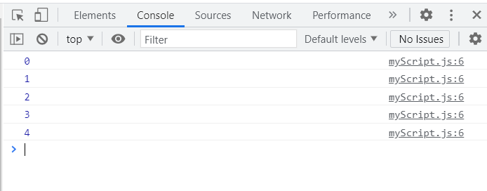
Loops - For
for (let iteration = 0; iteration < 5; iteration++) {
console.log(iteration);
}
Notes:
This is what will get logged to the console.

Slide 66
Loops - For
for (let iteration = 0; iteration < 5; iteration++) {
console.log(iteration);
}
Let’s go over it, iteration by iteration. Iteration 1:
First, iteration is set to 0
Secondly the condition is evaluated, and since 0 is less than 5 it will execute the code block.
Thirdly, the code block is executed, which means 0 will be logged to the console.
Lastly, iteration is incremented by 1.

Slide 67
Loops - For
for (let iteration = 0; iteration < 5; iteration++) {
console.log(iteration);
}
Iteration 2:
iteration is 1 at this point in time
First the condition is evaluated, and since 1 is less than 5 it will execute the code block.
Secondly, the code block is executed, which means 1 will be logged to the console.
Lastly, iteration is incremented by 1.

Slide 68
Loops - For
for (let iteration = 0; iteration < 5; iteration++) {
console.log(iteration);
}
Iteration 3:
iteration is 2 at this point in time
First the condition is evaluated, and since 2 is less than 5 it will execute the code block.
Secondly, the code block is executed, which means 2 will be logged to the console.
Lastly, iteration is incremented by 1.

Slide 69
Loops - For
for (let iteration = 0; iteration < 5; iteration++) {
console.log(iteration);
}
Iteration 4:
iteration is 3 at this point in time
First the condition is evaluated, and since 3 is less than 5 it will execute the code block.
Secondly, the code block is executed, which means 3 will be logged to the console.
Lastly, iteration is incremented by 1.

Slide 70
Loops - For
for (let iteration = 0; iteration < 5; iteration++) {
console.log(iteration);
}
Iteration 5:
iteration is 4 at this point in time
First the condition is evaluated, and since 4 is less than 5 it will execute the code block.
Secondly, the code block is executed, which means 4 will be logged to the console.
Lastly, iteration is incremented by 1.

Slide 71
Loops - For
for (let iteration = 0; iteration < 5; iteration++) {
console.log(iteration);
}
Iteration 6:
iteration is 5 at this point in time
First the condition is evaluated, and since 5 is not less than 5 the loop will end and nothing else will get logged to the console.

Slide 72
Quick - For loop index Demo

Slide 73
Loops – For/In
For/In makes loop iteration a bit easier. You can loop over an array like this:
let numbers = [5, 8, 9];
for(let index in numbers) {
console.log(numbers[index]);
}
Keyword and structure – This MUST be here

Slide 74
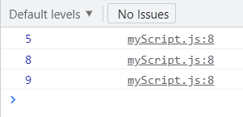
Loops – For/In
For/In makes loop iteration a bit easier. You can loop over an array like this:
let numbers = [5, 8, 9];
for(let index in numbers) {
console.log(numbers[index]);
}
Defined by you
Notes:
Above index is a variable you define that will get assigned the index of the current item in the array.
numbers in the ‘for’ loop definition is the name of the array you want to loop over.
You can access the value in the array with the syntax array[index].

Slide 75
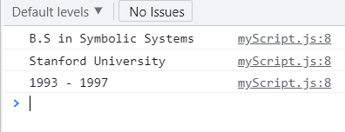
Loops – For/In
You can also loop over properties on an object like this:
let education = {name: "B.S in Symbolic Systems", institution: "Stanford University", period: "1993 - 1997"};
for(let key in education) {
console.log(education[key]);
}

Slide 76
Loops - While
While loops can execute a block of code as long as the specified condition is true.
This is the structure of a while loop.
while (condition) {
// code block to be executed
}
Keyword – This MUST be here

Slide 77
Loops - While
This is the structure of a while loop.
while (condition) {
// code block to be executed
}
Parentheses – Opening and closing parentheses MUST be directly after the while keyword

Slide 78
Loops - While
This is the structure of a while loop.
while (condition) {
// code block to be executed
}
If the condition evaluates to true, the code block will execute.
Condition for executing the code block
Notes:
This is pretty much the same thing that we saw for statement 2 on our for loop.

Slide 79
Loops - While
Let’s look at an example. Say you are tired of waiting for your friends to RSVP to your wedding and you’ve decided that you want to spam them with notifications until they RSVP. You could do that with a while loop:
while (!hasRSVPed) {
sendReminder(“You haven't RSVPed to our wedding");
}
Above if hasRSVPed is false (the condition evaluates to true) then the code block is executed.
This block of code will keep on executing until some process updates the hasRSVPed to true.

Slide 80
What if you want to break out of a loop?
break helps you to force exit a loop. Let’s use the same example from the previous slide, but this time we want to be more forgiving to our friends that have not RSVPed yet.
while (!hasRSVPed) {
if (hasValidExcuse) {
break;
}
sendReminder(“You haven't RSVPed to our wedding");
}
Keyword for breaking out of any loop
Notes:
Above on the condition that our friends have a valid excuse for not RSVPing yet, we can spare them from the spam notification by making use of ‘break’ to permanently exit the loop.
The order here is important, if you send the reminder before checking if your friend has a valid excuse then they will still receive one reminder.
You should always avoid a situation where your loop will execute infinitely, it just means there is nothing that will cause the loop to exit, and it will continue using resources until you eventually run our of memory.

Slide 81
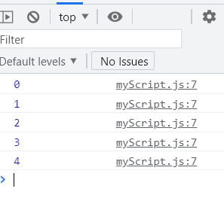
Loops - While
We could also achieve the same result that we had with the ‘for’ loop example, using a while loop.
let iteration = 0;
while (iteration < 5) {
console.log(iteration);
iteration++;
}
The biggest difference is that you must keep track of the iteration yourself.
Notes:
Do a verbal walkthrough of what happens for each iteration here.

Slide 82
Loops – Do While
This loop will execute the code block once, then it will repeat the loop as long as the condition is true. So, it will always execute the code block at least once.
This is the structure of a do/while loop.
do {
// code block to be executed
}
while (condition);
Keywords – This MUST be here

Slide 83
Loops – Do While
This is the structure of a do/while loop.
do {
// code block to be executed
}
while (condition);
Parentheses – Opening and closing parentheses MUST be directly after the while keyword

Slide 84
Loops – Do While
This is the structure of a do/while loop.
do {
// code block to be executed
}
while (condition);
As long as this condition evaluates to true the code block will execute.
Condition for executing the code block

Slide 85
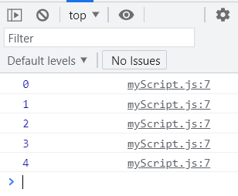
Loops - Do While
We could also achieve the same result that we had with the ‘for’ loop example, using a do while loop.
let iteration = 0;
do {
console.log(iteration);
iteration++;
}
while (iteration < 5);
Notes:
Do a verbal walkthrough of what happens for each iteration here.

Slide 86
When to use what kind of loop?
What loop should we use when we know how many times our loop should execute?

Slide 87
When to use what kind of loop?
What loop should we use when we know how many times our loop should execute?
We should use a for loop, since we have more control over the number of times the loop executes.

Slide 88
When to use what kind of loop?
What loop should we use when we want to repeat a section of code an unknown number of times until a specific condition is met?

Slide 89
When to use what kind of loop?
What loop should we use when we want to repeat a section of code an unknown number of times until a specific condition is met?
We should use a while loop.

Slide 90
When to use what kind of loop?
What loop should we use when we want to execute a block of code at least once?

Slide 91
When to use what kind of loop?
What loop should we use when we want to execute a block of code at least once, and then more times based on a condition?
We should use a do/while loop.

Slide 92
Activity
Get the CV navigation buttons to work. When clicking on the RESUME or CONTACT button we should be viewing the content applicable to the button clicked.
Notes:
Be sure to get the latest CV code from Github if you don’t have it already.
For this activity we’ll also be making use of our HTML skills. Show visual example of what the outcome should be.
You can decide what content to add on the RESUME and CONTACT page, but don’t focus too much on the content, rather focus on getting the navigation to work as it should.
As part of this activity, you can make use of functions, events and loops.

Slide 93
Thanks!
ANY QUESTIONS?

